Slide 1
Kovta Nyrt.
Created by SysTeam (Bánkuti Bálint, Szőke Kristóf)

Slide 2


Company history
Kovta Nyrt. is a newly launched bank. The entire bank network was designed for the company to start at the beginning and not expand, meaning everything is located in one building. The network is secure, transparent, and includes all basic protocols that are needed.

Slide 3
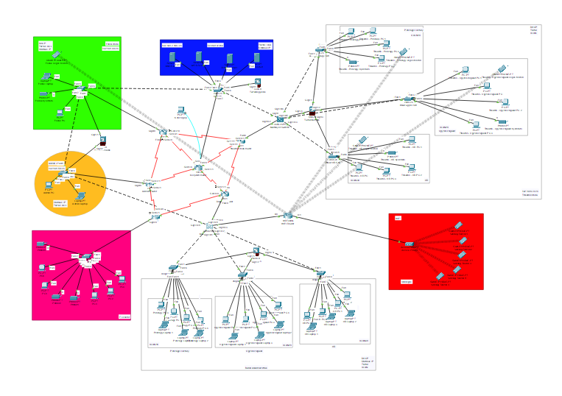
Offices
Offices:
Secretaries (Top Right)
Manager (Green)
System Administrator (Orange)
Bank Employees (Bottom)
Server Room (Blue)
IT sector (Pink)
Common Area (Red)

Slide 4
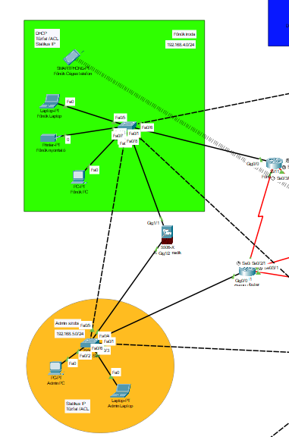
Manager Office & Admin Office
Firewall protects the most secure offices in the network
There is static address translation at the admin office, and dynamic at the boss's office.
Admin laptop and PC receive static IP addresses
Manager PC has static IP assignment
DHCP:
Manager phone via WiFi on a different network than common area phones
Manager laptop
Manager printer

Slide 5
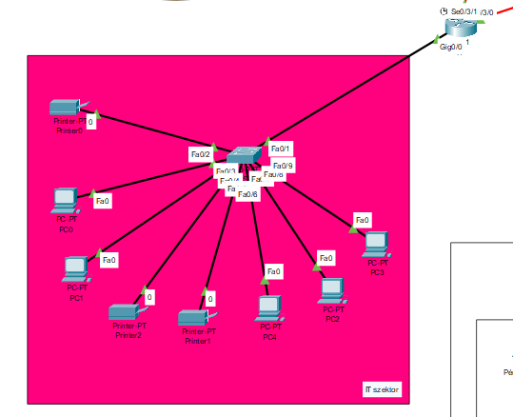
IT Sector
In this sector, we used IPv6 addressing.
Every machine receives IP addresses statically.
The router named "IT" is responsible for this sector.
Sector components include:
3 printers
5 computers
1 switch

Slide 6
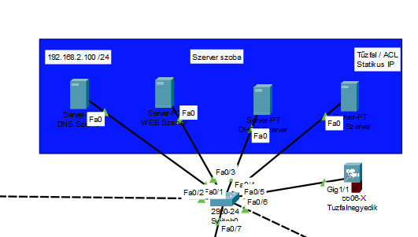
Server room
This is the network's server room.
4 servers are located here:
WEB: hosts our team's website
DHCP: server dynamically distributes IP addresses to devices
FTP: network device configurations are backed up on this server
DNS: translates domain names to IP addresses and vice versa

Slide 7
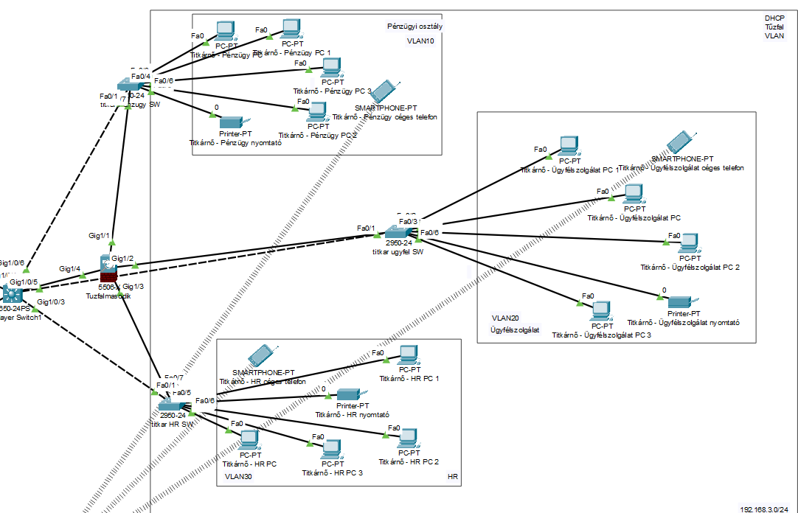
Secretaries Office
The secretaries section is divided into 3 VLANs
A firewall also operates in this network segment
Finance - VLAN 10
Customer Service - VLAN 20
HR - VLAN 30
Devices in different VLANs receive IP addresses through sub-interfaces
The multilayer switch performs basic switching tasks in the network

Slide 8
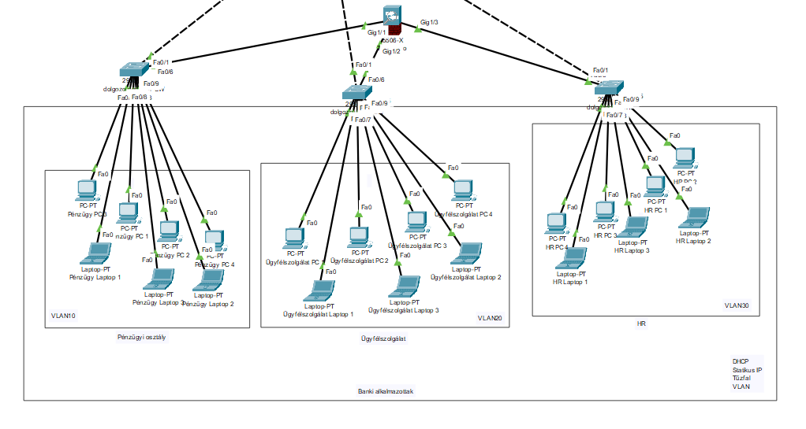
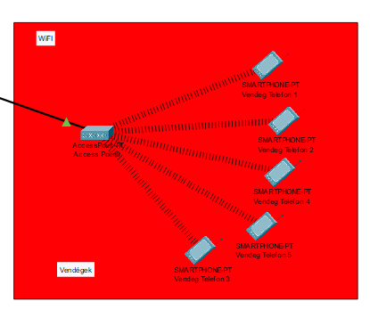
Employees Office & Common Area
Similar structure to the secretaries office
3 VLANs (HR, Finance, Customer Service)
DHCP thrugh sub-interfaces
ACL: VLAN 20 can see others but this is not reciprocal
Common Area:
WIFI router, Access point and phones

Slide 9
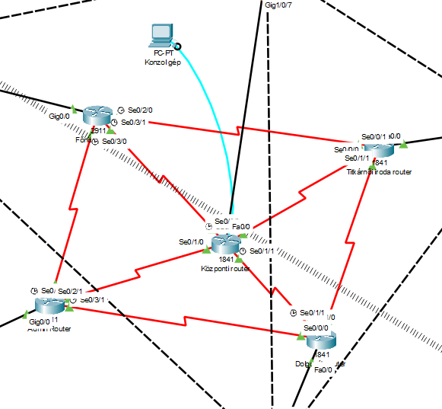
Redundancy
A router "ring" is located in the center of the network
All routers are interconnected with each other, this is redundancy
This technology is a backup system
If one router fails, information will reach from point A to point B via the fastest possible route

Slide 10
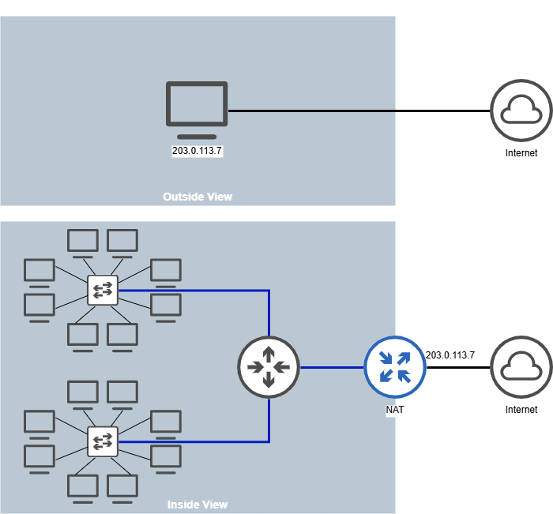
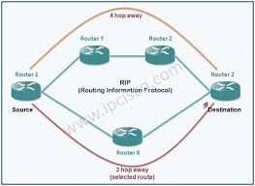
NAT-PAT és RIP protocol
NAT translates private IP addresses to public IP addresses.
It runs on a router at the boundary between internal and external networks.
PAT (Port Address Translation) enables multiple devices to communicate through a single IP.
RIP (Routing Information Protocol) is a distance-vector routing protocol that shares network information only with neighbors.

Slide 11
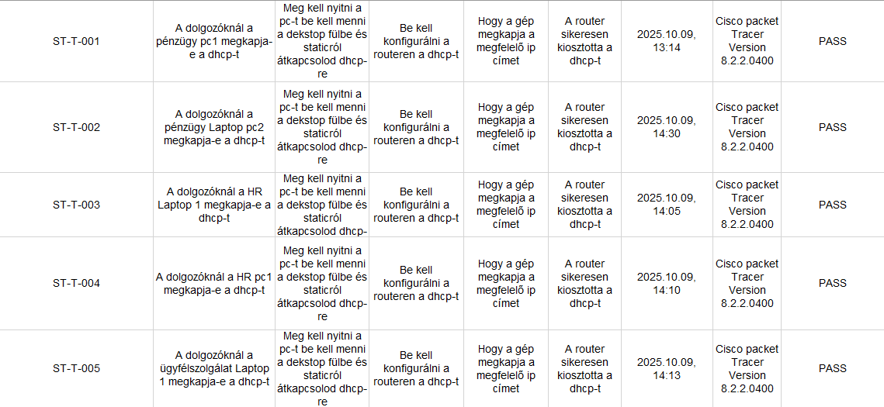
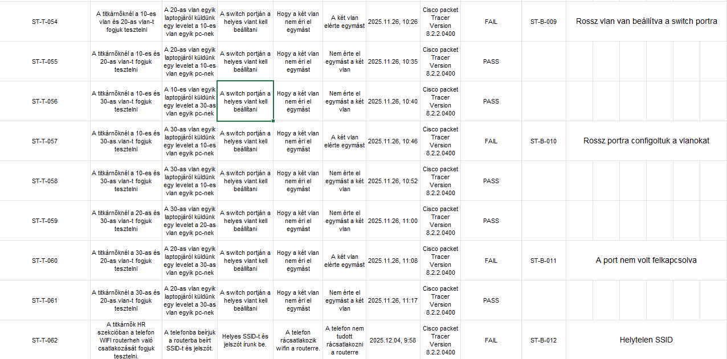
Testing

Slide 12
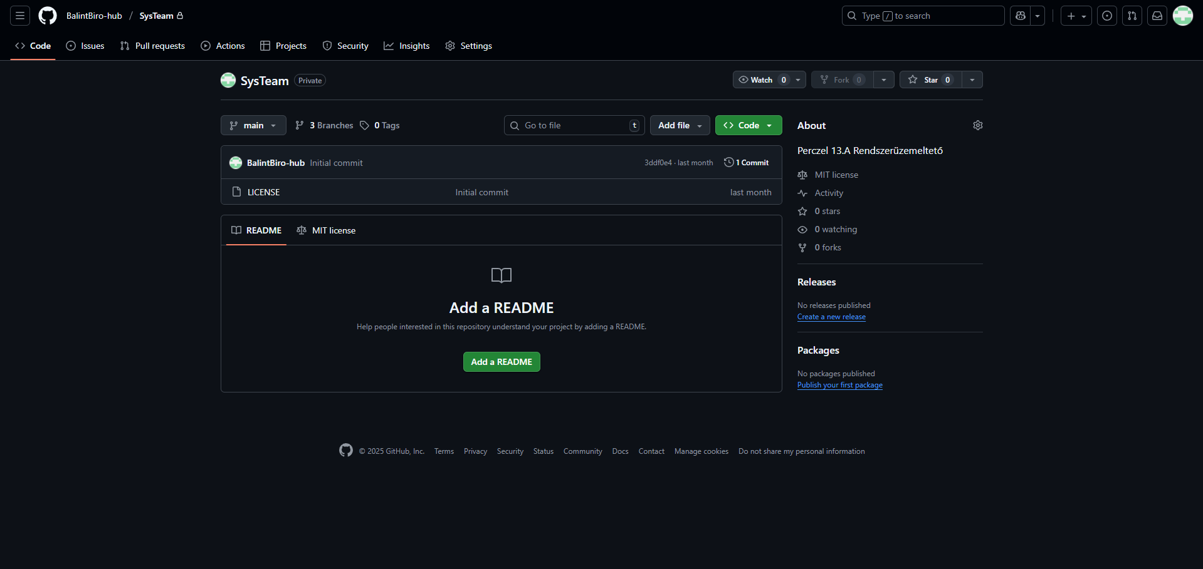
GIT
Git is a version control system that can be used for efficient management and tracking of code changes. It enables developers to manage different file versions and modifications, allowing restoration to previous states.

Slide 13
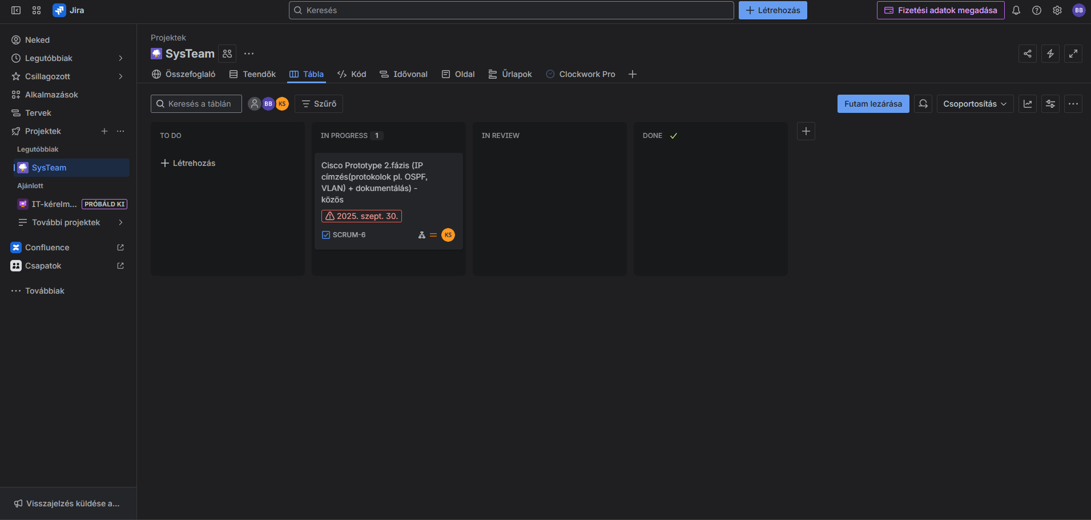
Jira
We log work hours in Jira. This platform is used to verify at the end whether actual work was done during the year or if the project was just hastily assembled.

Slide 14
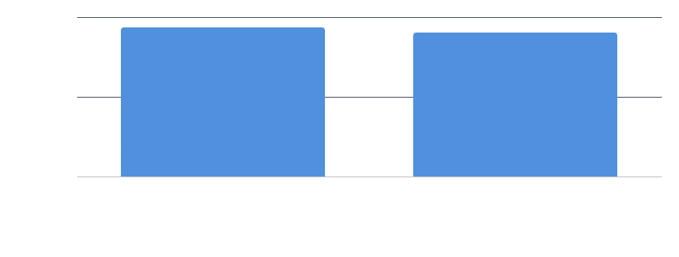
Team Time Distribution

Slide 15
Thank you

